Slide 1
GPS
RBE-F17-011-03
Adj. Prof. Julian Center

Slide 2

------Using GIS--
NR 143/385
INTRODUCTION TO GPS
Global Positioning Systems
GPS
Many materials for this lecture adapted from Trimble Navigation Ltd’s GPS Web tutorial
at http://trimble.com/gps/index.shtml as well as from lectures originally prepared
by Austin Troy, Robert Long, Gerald Livingston, and Leslie Morrissey

Slide 3
GPS
What is it?
How does it work?
Errors and Accuracy
Ways to maximize accuracy
System components

Slide 4
GPS
Stands for Global Positioning System
GPS is used to get an exact location on or above the surface of the earth (1cm to 100m accuracy).
Developed by DoD and made available to public in 1983.
GPS is a very important data input source.
GPS is one of two (soon to be more) GNSS – Global Navigation Satellite System
Notes:
used for surveying, military operations, engineering, vehicle tracking, flight navigation, car navigation, ship navigation, unmanned vehicle guidance, agriculture, and of course, mapping.

Slide 5
GNSS
NAVSTAR – U.S. DoD (“GPS”)
GLONASS – Russian system
Galileo – European system (online in 2019?)
Compass/BeiDou-2 – Chinese system in development (operational with 10 satellites as of December, 2011; 35 planned)
GPS and GLONASS are free to use!
Notes:
used for surveying, military operations, engineering, vehicle tracking, flight navigation, car navigation, ship navigation, unmanned vehicle guidance, agriculture, and of course, mapping.

Slide 6
GPS Uses
Trimble Navigation Ltd., breaks GPS uses into five categories:
  Location – positioning things in space
  Navigation – getting from point a to point b
  Tracking - monitoring movements
  Mapping – creating maps based on those positions
  Timing – precision global timing

Slide 7
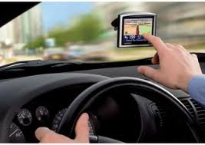
GPS Uses
Agriculture
Surveying
Navigation (air, sea, land)
Engineering
Military operations
Unmanned vehicle guidance
Mapping

Slide 8
GPS Uses
Here are just a few mapping examples:
  Centerlines of roads
  Hydrologic features (over time)
  Bird nest/colony locations (over time)
  Fire perimeters
  Trail maps
  Geologic/mining maps
  Vegetation and habitat

Slide 9
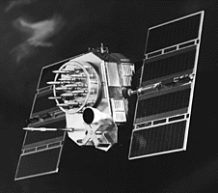

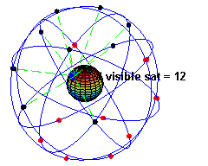
GPS
GPS uses satellites in space as reference points for locations here on earth

Slide 10
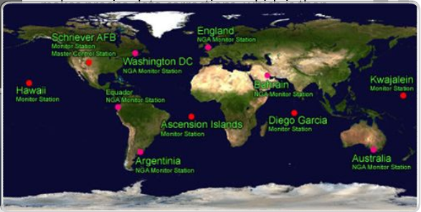
GPS
11 monitor stations help satellites determine their exact location in space. Five original stations:
  Hawaii
  Ascension Island
  Diego Garcia
  Kwajalein
  Colorado Springs (control)

Slide 11
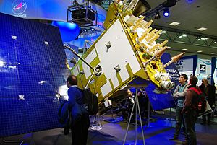
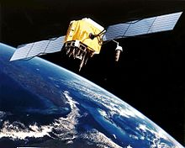
GNSS comparison
GLONASS
  24 satellites (100% deployed)
  3 orbital planes
GPS
  31 satellites (>100% deployed)
  6 orbital planes

Slide 12


How does GPS work?
GPS receiver determines its position relative to satellite “reference points”
The GPS unit on the ground figures out its distance (range) to each of several satellites
12,500 km
11,200 km
11,500 km

Slide 13

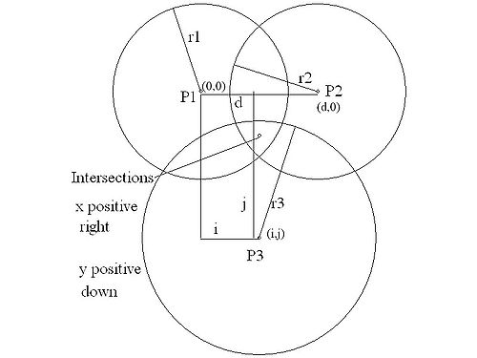
How Does GPS Work?
We need at least 3 satellites as reference points
Position is calculated using trilateration (similar to triangulation but with spheres)

Slide 14
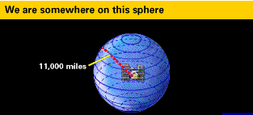
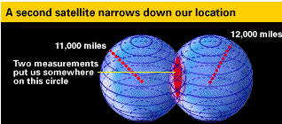
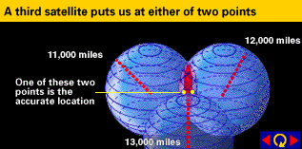
How Does GPS Work?
Sphere Concept
Source: Trimble Navigation Ltd.
A fourth satellite narrows it from 2 possible points to 1 point

Slide 15
How Does GPS Work?
This method assumes we can find exact distance from our GPS receiver to a satellite. HOW???
Simple answer: see how long it takes for a radio signal to get from the satellite to the receiver.
We know speed of light, but we also need to know:
Distance = Velocity * Time
        When the signal left the satellite
        When the signal arrived at the receiver

Slide 16
How Does GPS Work?
The difficult part is measuring travel time (~.06 sec for an overhead satellite)
This gets complicated when you think about the need to perfectly synchronize satellite and receiver. (A tiny synch error can result in hundreds of meters of positional accuracy)
Notes:
1. amount of time elapsed is tiny (about .06 seconds for an overhead satellite), and we require a way to know precisely WHEN the signal left the satellite

Slide 17
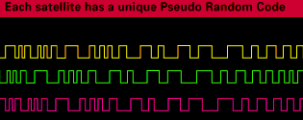
How Does GPS Work?
To do this requires comparing lag in pseudo-random code, one from satellite and one generated at the same time by the receiver.
This code has to be extremely complex (hence almost random), so that patterns are not linked up at the wrong place on the code.
Sent by satellite at time t₀
Received from satellite at time t₁
Source: Trimble Navigation Ltd.
Notes:
2. that would generate the wrong time delay and hence the wrong distance.

Slide 18
How Does GPS Work?
Assumption: The code also has to be generated from each source at exactly the same time. (1/1000th sec means 200 miles of error!)
So, the satellites have expensive atomic clocks that keep nearly perfect time—that takes care of their end.
But what about the ground receiver?
Notes:
1. if they’re off by 1/1000th of a second, that means 200 m of error.

Slide 19
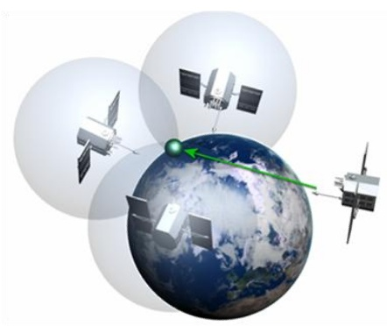
How Does GPS Work?
Here is where the fourth satellite signal comes in.
If 3 perfect satellite signals can give a perfect location, 4 imperfect signals can do the same and also reveal discrepancies (or validate the other 3)
Remember the sphere example…
If receiver clock is correct, 4 circles should meet at one point. If they don’t meet, the computer knows there is an error in the clock: “They don’t add up”

Slide 20
How Does GPS Work?
A fourth satellite allows a correction factor to be calculated that makes all circles meet in one place.
This correction is used to update the receiver’s clock.

Slide 21
How Does GPS Work?
The receiver then knows the difference between its clock’s time and universal time and can apply that to future measurements.
Of course, the receiver clock will have to be resynchronized often, because it will lose or gain time

Slide 22
Accuracy Depends On:
Time spent on measurements
Location
Design of receiver
Relative positions of satellites
Use of differential techniques

Slide 23
Sources of Error
Gravitational effects
Atmospheric effects
Obstruction
Multipath
Satellite geometry
Selective Availability

Slide 24
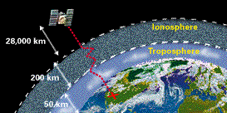
Errors and Accuracy
Gravitational pull of other celestial bodies on the satellite, affecting orbit
Atmospheric effects - signals travel at different speeds through ionosphere and troposphere.
  Both of these errors can be partly dealt with using predictive models of known atmospheric behavior and by using Differential GPS.
Source: Trimble Navigation Ltd.

Slide 25
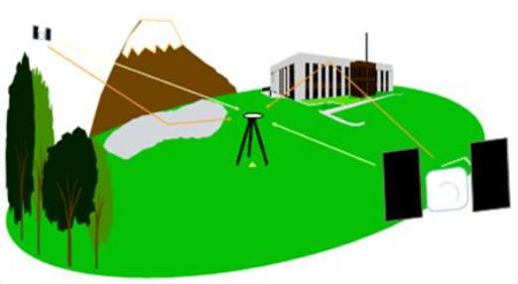
Errors and Accuracy
Obstruction - Signal blocked or strength reduced when passing through objects or water.
  Weather
  Metal
  Tree canopy
  Glass or plastic
  Microwave transmitters
Multipath – Bouncing of signals may confuse the receiver.
Notes:
2. Better receivers have algorithms that can deal with this by determining what counts as a multi-path signal and choosing the first one as the signal to use.

Slide 26
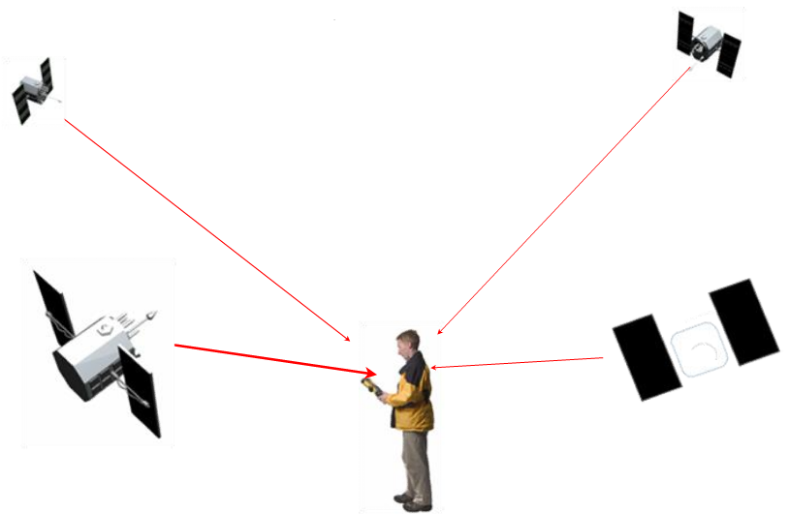
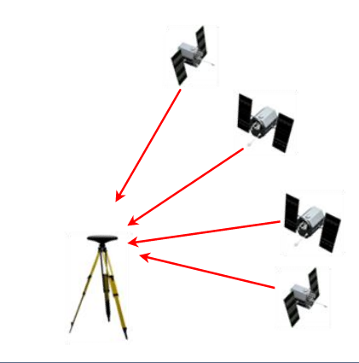
Errors and Accuracy
Satellite Constellation Geometry
  Number of satellites available
  Elevations or azimuths over time
Positional Dilution of Precision
(P.D.O.P.)

Slide 27
Errors and Accuracy
PDOP
  Indicator of satellite geometry
  Accounts for location of each satellite relative to others
  Optimal accuracy when PDOP is LOW
Satellite 1
Satellite 1
Satellite 2
Satellite 2
Low PDOP
High PDOP

Slide 28
Locating Satellites
We know how far we are from the satellites, but how do we know where the satellites are?
Because the satellites are 20,000 km up, they operate according to the well understood laws of physics, and are subject to few random, unknown forces.
This allows us to know where a satellite should be at any given moment.
Also tracked by radar to measure slight deviations from predicted orbits.

Slide 29
Locating Satellites
This location information (ephemeris) is relayed to the satellite, which transmits the info when it sends its pseudo-random code.
There is also a digital almanac on each GPS receiver that tells it where a given satellite is supposed to be at any given moment.
Other information is relayed along with the radio signal: time-of-day, date, health, quality control info.
Notes:
Ephemeris is precise location (orbit) of each satellite -> unique; almanac is general, long-term approx. location of all satellites

Slide 30
Errors and Accuracy
Selective Availability (S.A.)
  Until May of 2000, the DoD intentionally introduced a small amount of error into the signal for all civilian users.
  SA resulted in about 100 m error most of the time
  Turning off SA reduced error to about 30 m radius

Slide 31
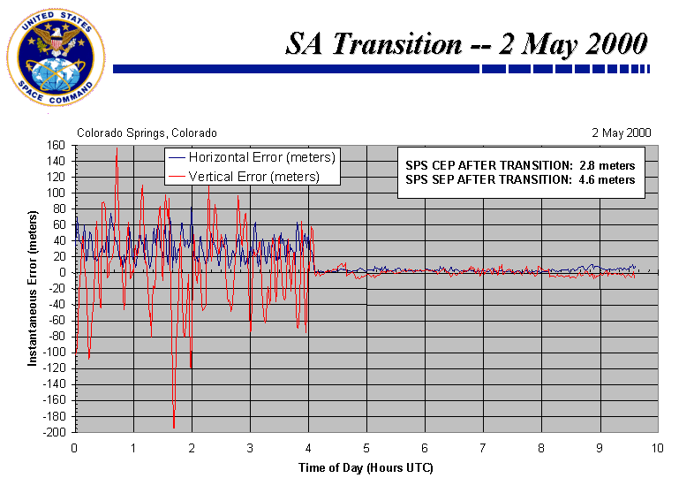
Elimination of SA

Slide 32

Ensuring Accurate Locations
Adequate satellites
  Low PDOP (≤ 3 excellent, 4-7 acceptable)
  Averaging
Clear weather
Minimize multipath error
Use open sites
Appropriate planning (ephemeris, skyplots)
> USE DIFFERENTIAL GPS

Slide 33
Differential GPS
Increase accuracy dramatically
This was used in the past to overcome Selective Availability (100m to 4-5m)
DGPS uses one stationary and one moving receiver to help overcome the various errors in the signal
By using two receivers that are nearby each other, within a few dozen km, they are getting essentially the same errors (except receiver errors)
Notes:
2. with that gone, is now used for reducing the 30m error

Slide 34
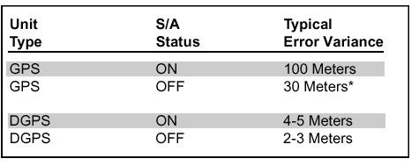
Differential GPS
INTRODUCTION TO GPS
DGPS improves accuracy much more than disabling of SA does
This table shows typical error—these may vary
Source: http://www.furuno.com/news/saoff.html

Slide 35
How does DGPS work?
The stationary receiver must be located on a known control point
The stationary unit works backwards—instead of using timing to calculate position, it uses its position to calculate timing
Notes:
Accurately surveyed E.g. USGS benchmarks
It determines what the GPS signal travel time should be and compares it with what it actually is

Slide 36
How does DGPS work?
Can do this because precise location of stationary receiver is known, and hence, so is location of satellite
Once it knows error, it determines a correction factor and sends it to the other receiver.

Slide 37
How does DGPS work?
Message sent to rover with correction factor for all satellites.
More reference stations becoming available.
Notes:
It used to be that only big companies and governments could use DGPS because they had to set up their own reference receiver station
Now there are many public agencies that maintain them, especially the Coast guard; these stations broadcast on a radio frequency, which GPS receivers with a radio receiver can pick up

Slide 38
Other DGPS Concepts
Real-time vs. Post-processing
Augmented GPS
  Wide Area Augmentation System (WAAS)
  Local Area Augmentation System (LAAS)
Inverted GPS – DGPS on a budget
Notes:
Real-time: Base station calculates and broadcasts error as receives data. Rover receives info and applies correction as position being calculated.
Post-processed: Based station records errors into digital file. Differentially corrected later on PC.
2. 25 ground reference stations and master ground station that almost instantaneously processes and sends out satellite errors
Improves error to 7 m
WAAS: system of fixed reference stations that monitor and correct GPS signals and transmit them to other geostationary comm satellites via uplink stations. WAAS receivers can receive both GPS from the NAVSTAR satellites and corrections from the comm satellites, making for highly accurate positioning (developed for aircraft navigation).
LAAS: similar to WAAS but ground-based
Inverted GPS: a fleet of standard GPS receivers can transmit their positions back to central location where a single reference station and computer can calculate the corrections and transmit those back to the mobile receivers.

Slide 39
Error Budget
Typical Error (meters) | Standard GPS | Differential GPS
Satellite Clocks | 1.5 | 0
Orbit Errors | 2.5 | 0
Ionosphere | 5.0 | 0.4
Troposphere | 0.5 | 0.2
Receiver Noise | 0.3 | 0.3
Multipath | 0.6 | 0.6

Slide 40
System Components
Receiver
  Receives satellite signals
  Compiles location info, ephemeris info, clock calibration, constellation configuration (PDOP)
  Calculates position, velocity, heading, etc…
Data Collector
  Stores positions (x,y,z,t)
  Attribute data tagged to position
Software
  Facilitates file transfer to PC and back
  Performs differential correction (post-processing)
  Displays data and permits file editing.

Slide 41
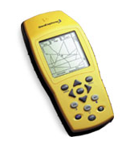
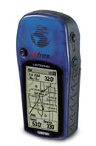
System Components - Receivers
Course/Acquisition (C/A) Code Receivers
  Civilian grade
  Use info in satellite signals to calculate position
  12-40m CEP* without differential correction
  <1-5m CEP with differential correction
  Do not need to maintain constant
  communication (lock) with satellites
  Can be used under forest canopy
15m
CEP: 50% of positions are within a horizontal circle of a radius equal to the specified length.

Slide 42
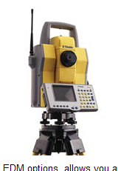
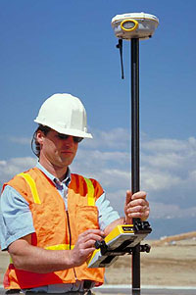
System Components - Receivers
Carrier Phase (P-Code) Receivers
  Military or survey grade
  Uses actual radio signal to calculate position
  ± 1cm SEP* (50% of locations within sphere of this radius)
  Must record positions continuously from at least 4 satellites for at least 10 minutes – requires clear view
Number of Channels
  4 satellites for accurate 3D positions, 5 or more for highest accuracy
  9-12 channels required to track all visible satellites at given moment

